Slide 1

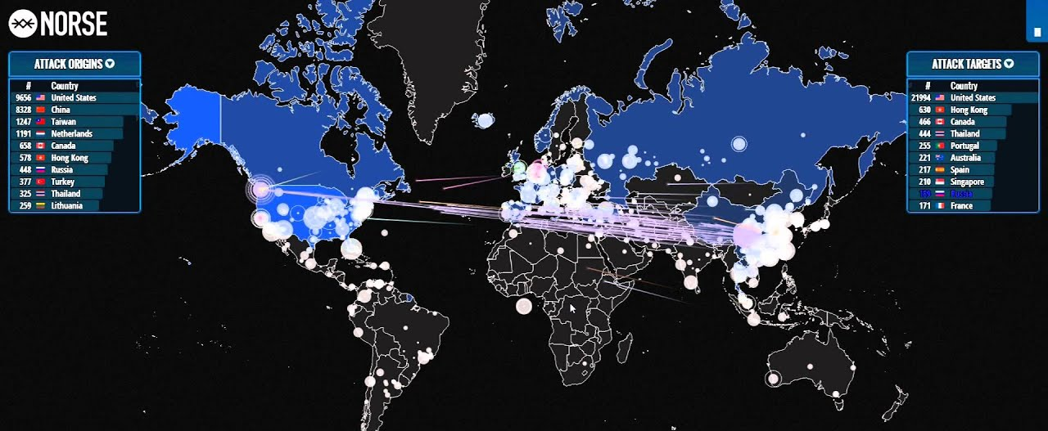
Detection of DOS & DDOS Attacks using Machine Learning

Slide 2
Outline
What is a DOS and a DDOS attack?
How can they be identified?
Who and why are these attacks performed?
What are the types of DDOS attack?
Examples of DDOS attack
Project Data
What is yet to be done?

Slide 3
DOS Attack
Denial Of Service is a cyber attack intended to shut down a machine or a network by flooding the targeted network with constant flood of traffic, such as fraudulent requests which overwhelms the system making it inaccessible to its intended users.
Attacker generates multiple requests only from the single computer (source) which contains the DOS Software.
Though DOS attacks do not typically result in the theft or loss of significant information or other assets, they can cost the victim a great deal of time and money to handle.

Slide 4
DDOS Attack
Distributed Denial of Service is similar to DOS. The only difference is instead from generating requests from a single source the attackers utilizes a large network of remote PCs called Botnet
Exploited machines can include computers and other networked resources.

Slide 5
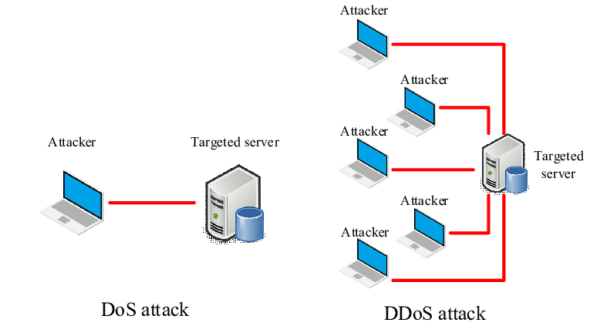
DOS & DDOS Attack

Slide 6
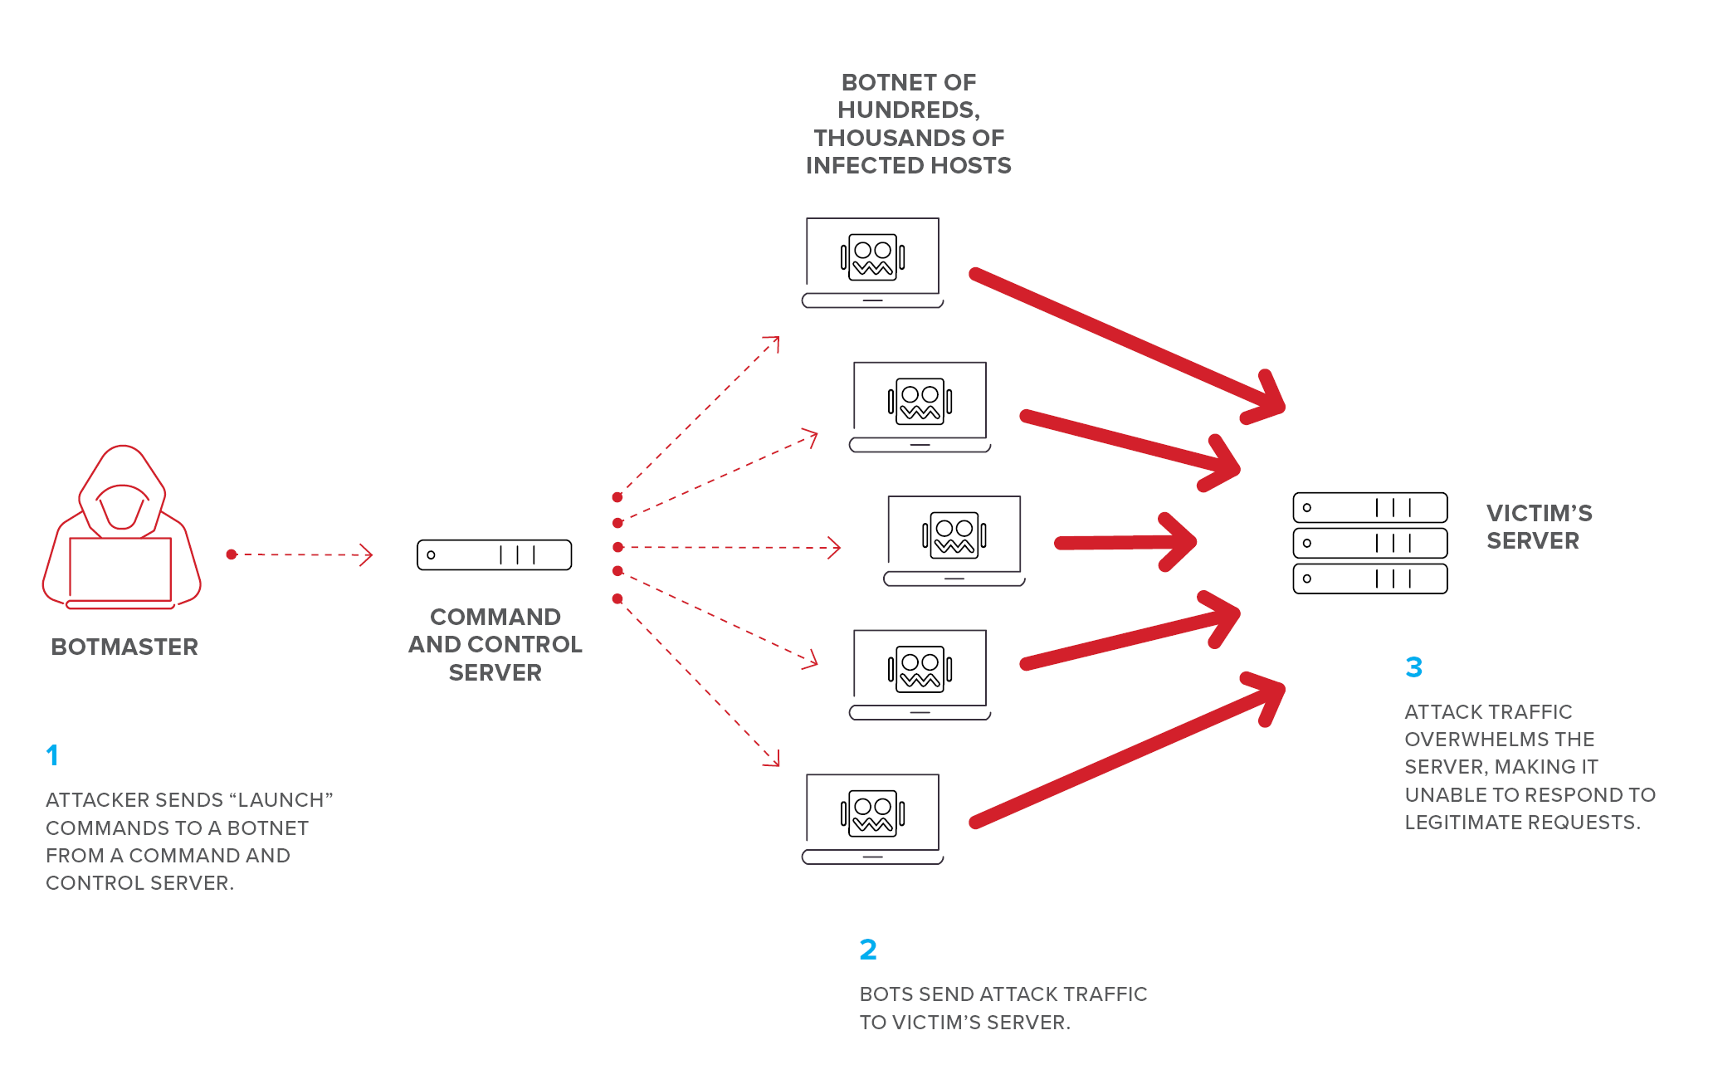
DDOS Attack - Picture

Slide 7
Identifying a DDOS Attack
The most obvious symptom of a DDoS attack is a site or service suddenly becoming slow, unavailable or showing some unexpected consequences.
Traffic analytics tools can help you spot some of these telltale signs of a DDoS attack:
Suspicious amounts of traffic originating from a single IP address or IP range
A flood of traffic from users who share a single behavioral profile, such as device type, geolocation, or web browser version
An unexplained surge in requests to a single page or endpoint
Odd traffic patterns such as spikes at odd hours of the day or patterns that appear to be unnatural (e.g., a spike every 10 minutes)

Slide 8
Who & Why they perform DDOS Attack
Generally, we don’t have a definitive answer to say who will perform DDOS Attacks.
But we can understand the reasons to perform DDOS Attack:
Some (not-so) Friendly Competition
Ransom (gambling companies, financial companies during the 2000s)
DDOS for Hacktivism
All about Politics
Revenge

Slide 9
Types Of DDOS Attacks
To begin with, there are three overarching categories of these attacks that form the backbone of this ecosystem:
Application layer (layer 7 DDoS) attacks
Protocol attacks
Volume-based (volumetric) attacks

Slide 10
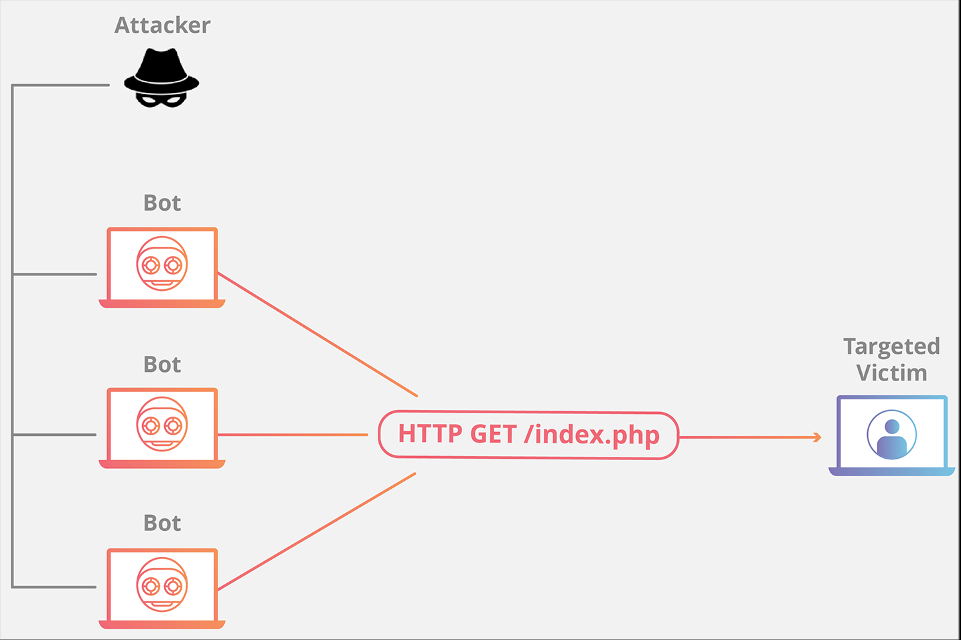
Application Layer Attacks
The goal of the attack:
the goal of these attacks is to exhaust the target’s resources to create a denial-of-service.
Example: HTTP Flood

Slide 11
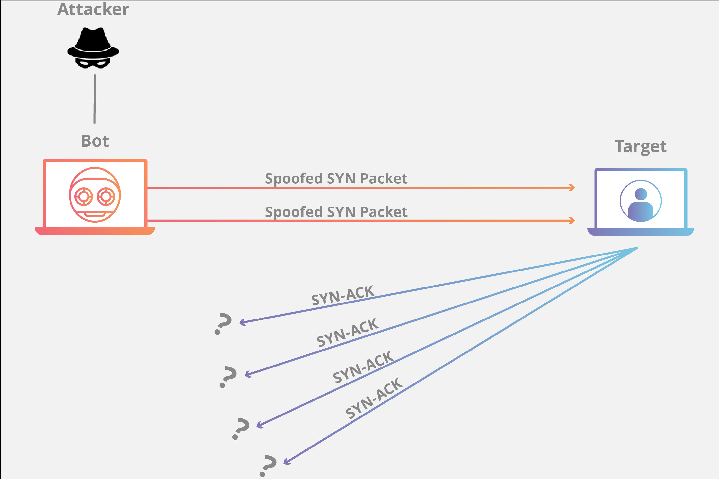
Protocol Attacks
The goal of the attack:
cause a service disruption by over-consuming server resources and/or the resources of network equipment like firewalls and load balancers.
Example: SYN Flood

Slide 12
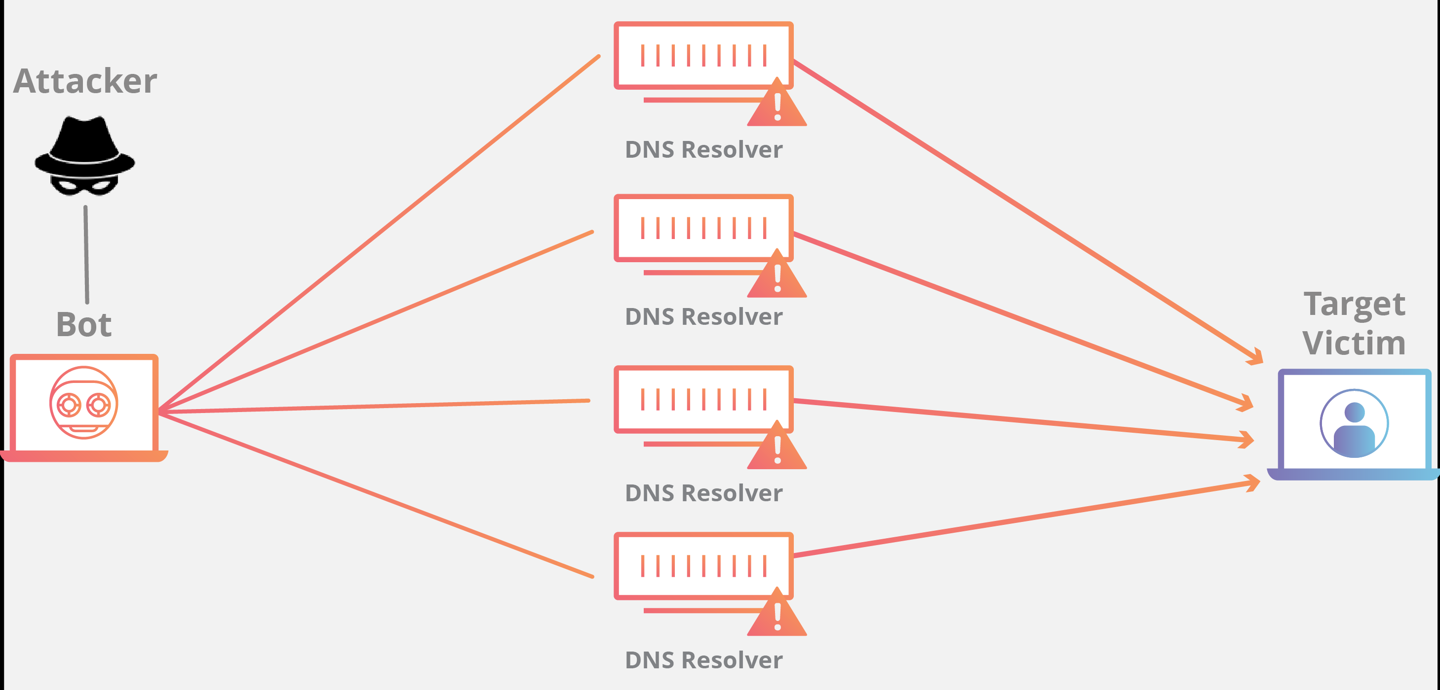
Volumetric Attacks
The goal of the attack:
This attack attempts to create congestion by consuming all available bandwidth between the target and the larger Internet.
Example: DNS Amplification

Slide 13
Mitigating a DDOS Attack
The key concern in mitigating a DDoS attack is differentiating between attack traffic and normal traffic.
A multi-vector DDoS attack uses multiple attack pathways in order to overwhelm a target in different ways, potentially distracting mitigation efforts on any one trajectory.
An attack that targets multiple layers of the protocol stack at the same time, such as a DNS amplification (targeting layers 3/4) coupled with an HTTP flood (targeting layer 7) is an example of multi-vector DDoS.

Slide 14
Mitigating a DDOS Attack…
In order to overcome a complex attempt at disruption, a layered solution will give the greatest benefit.
Blackhole routing
Rate limiting
Web application firewall
Anycast network diffusion

Slide 15
DDOS Attacks - Examples
The Google Attack, 2017
The AWS DDoS Attack in 2020
The Mirai Krebs and OVH DDoS Attacks in 2016
The Mirai Dyn DDoS Attack in 2016
The Six Banks DDoS Attack in 2012
The GitHub Attack in 2018

Slide 16
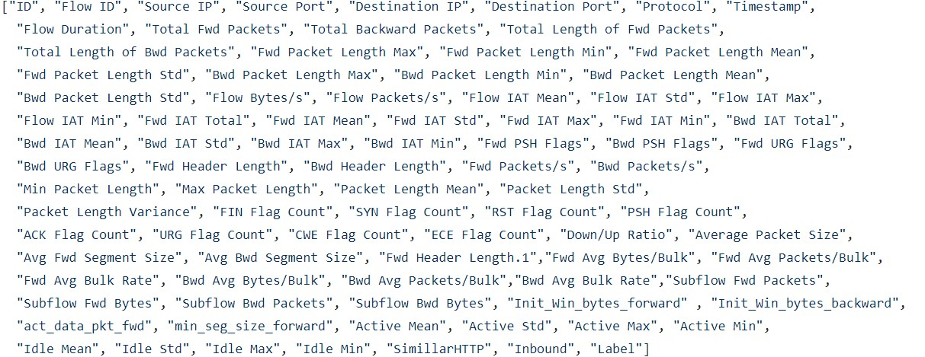
Dataset 1
Number of features: 88

Slide 17
Dataset
Attacks included in our data :
DNS
LDAP
MSSQL
NETBIOS
NTP
SNMP
SSDP
UDP
SYN
TFTP
UDP-LAG

Slide 18
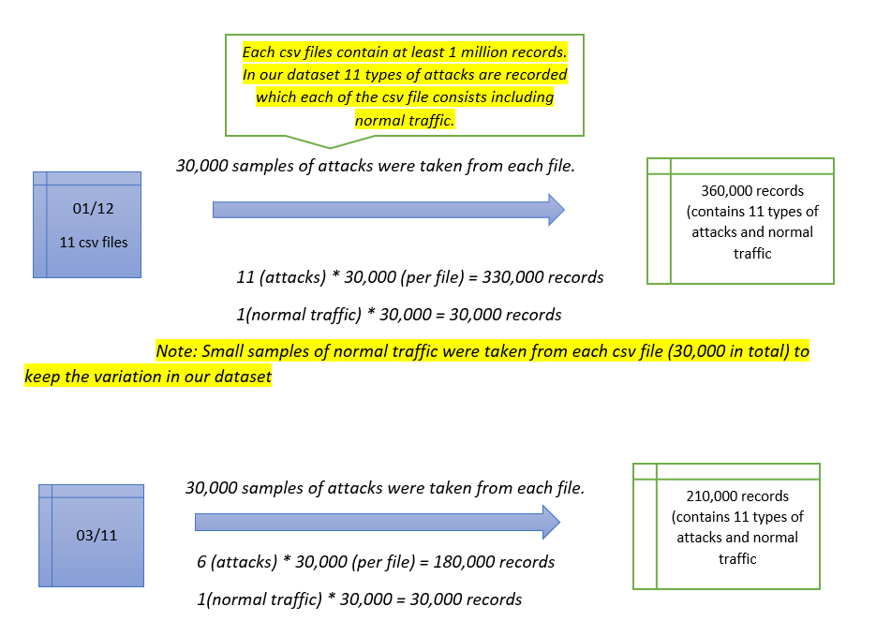
Data preprocessing

Slide 19
Data cleaning
All the observations with missing values were removed from the dataset.
All the inf/ -inf values were replaced by 0.
Our target variable was converted to numerical by replacing all the attacks by 1 and benign traffic by 0.

Slide 20
Feature engineering
To select the best features that are significant to determine our target variable we used several feature engineering techniques.
Correlation Heat map
Feature Importance
Univariate
After using all these techniques,15 most significant features were selected. These features were obtained by selecting the features that fall under top 15 for more than one technique used.

Slide 21
ML algorithms
KNN
Decision Tree
Random Forest
Naïve Bayes
Support vector machine
Stochastic Gradient Boosting

Slide 22
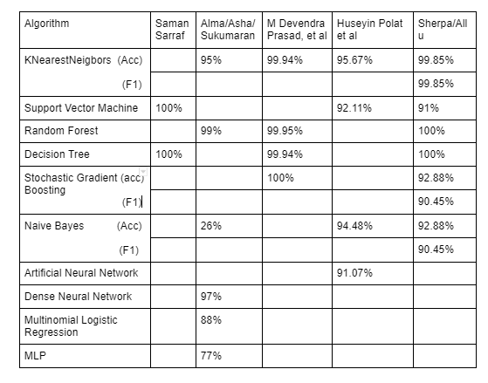
Similar works

Slide 23
Results
Among all the algorithms we have used, Decision tree and Random Forest showed the best performance.
All models were validated using 10 cross-fold validation.
Without classifying the kind of attack, we have considered Random Forest as the model we want to use.

Slide 24
References
https://www.securitymagazine.com/articles/92327-are-you-ready-for-these-26-different-types-of-ddos-attacks
https://www.cloudflare.com/learning/ddos/what-is-a-ddos-attack/
https://cybersecurity.att.com/blogs/security-essentials/types-of-ddos-attacks-explained
https://www.pentasecurity.com/blog/ddos-top-6-hackers-attack/
https://www.a10networks.com/blog/5-most-famous-ddos-attacks/

